Slide 1
Introduction to Python

Slide 2
Interpreter
Interpreter: translates and executes instructions in high-level language program
Used by Python language
Interprets one instruction at a time
No separate machine language program
Source code: statements written by programmer
Syntax error: prevents code from being translated

Slide 3
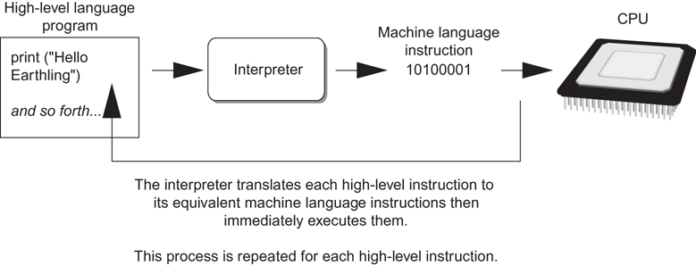
Compliers and Interpreters

Slide 4
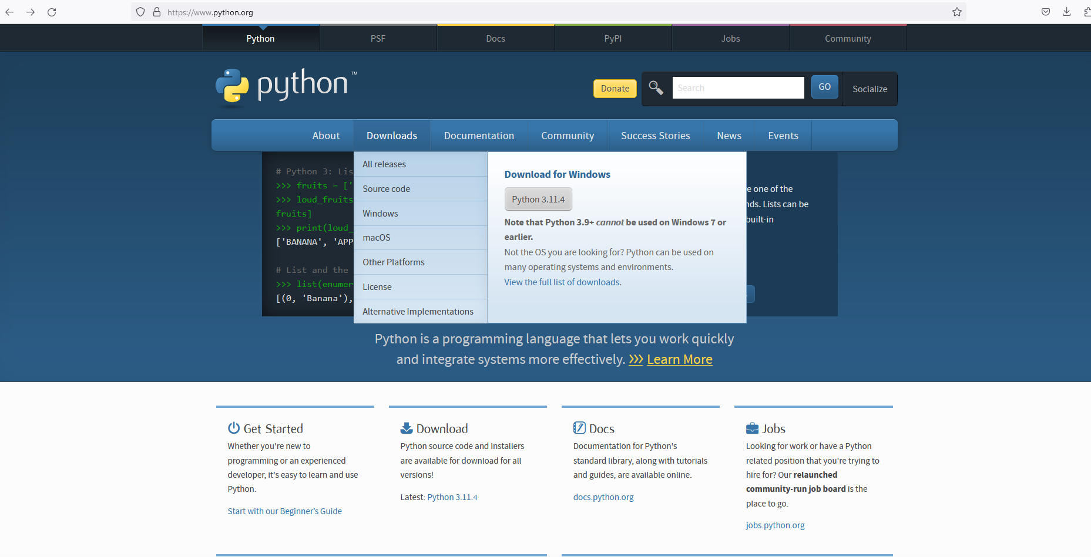
How to Download Python
Go to the official Python webpage and download the latest version of Python to your computer
www.python.org

Slide 5
The IDLE Programming Environment
IDLE (Integrated Development Program): single program that provides tools to write, execute and test a program
Automatically installed when Python language is installed
Runs in interactive mode
Has built-in text editor with features designed to help write Python programs

Slide 6
Interactive Mode
When you start Python in interactive mode, you will see a prompt
Indicates the interpreter is waiting for a Python statement to be typed
Prompt reappears after previous statement is executed
Error message displayed If you incorrectly type a statement

Slide 7
Why Python
It is a language that someone can learn easily
Commands are English-like which helps to read the code and understand the code easily
It is a language which you can write fast
Intuitive
Very popular in data science and applications
Consisting libraries for scientific computation, great applications for machine learning and natural language processing

Slide 8
Writing Python Programs and Running Them in Script Mode
Statements entered in interactive mode are not saved as a program
To have a program use script mode
Save a set of Python statements in a file
The filename should have the .py extension
To run the file, or script, type
python filename
at the operating system command line

Slide 9
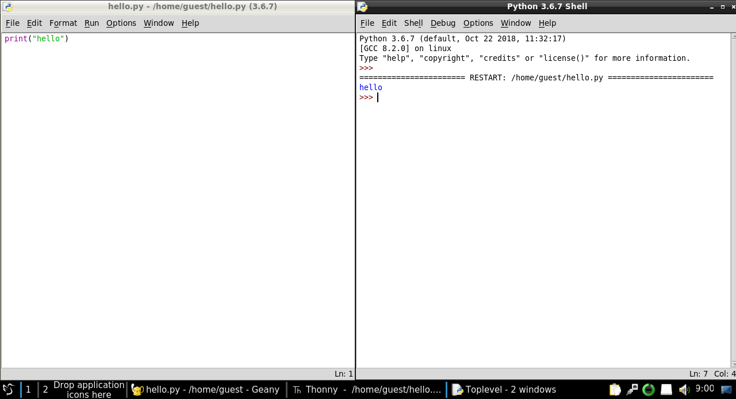
Python Shell and Editor
Editor window
You need to write your code here
and save it to your computer then Run
Output window
Whatever you code on the editor the output
will display on this window. This is called
Shell window.

Slide 10
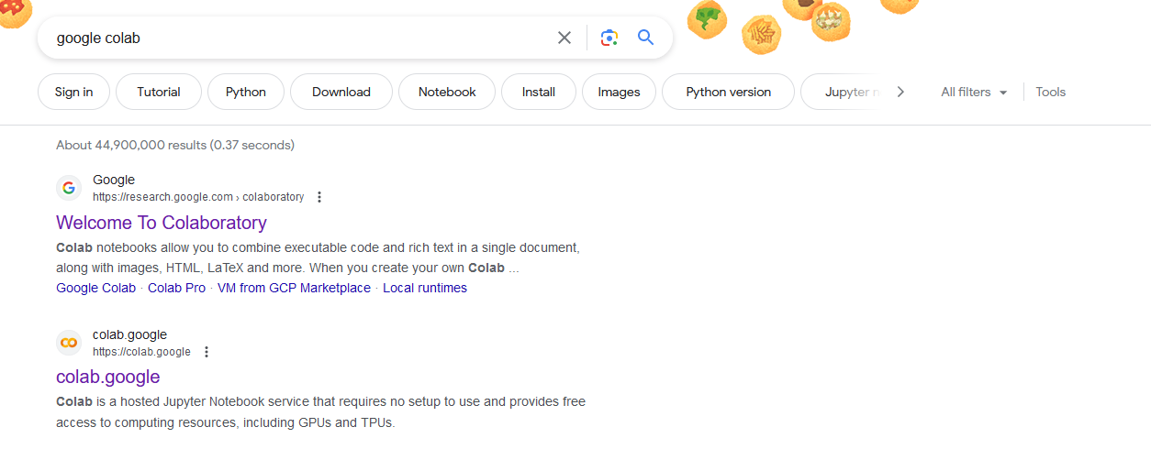
Google Colaboratory

Slide 11
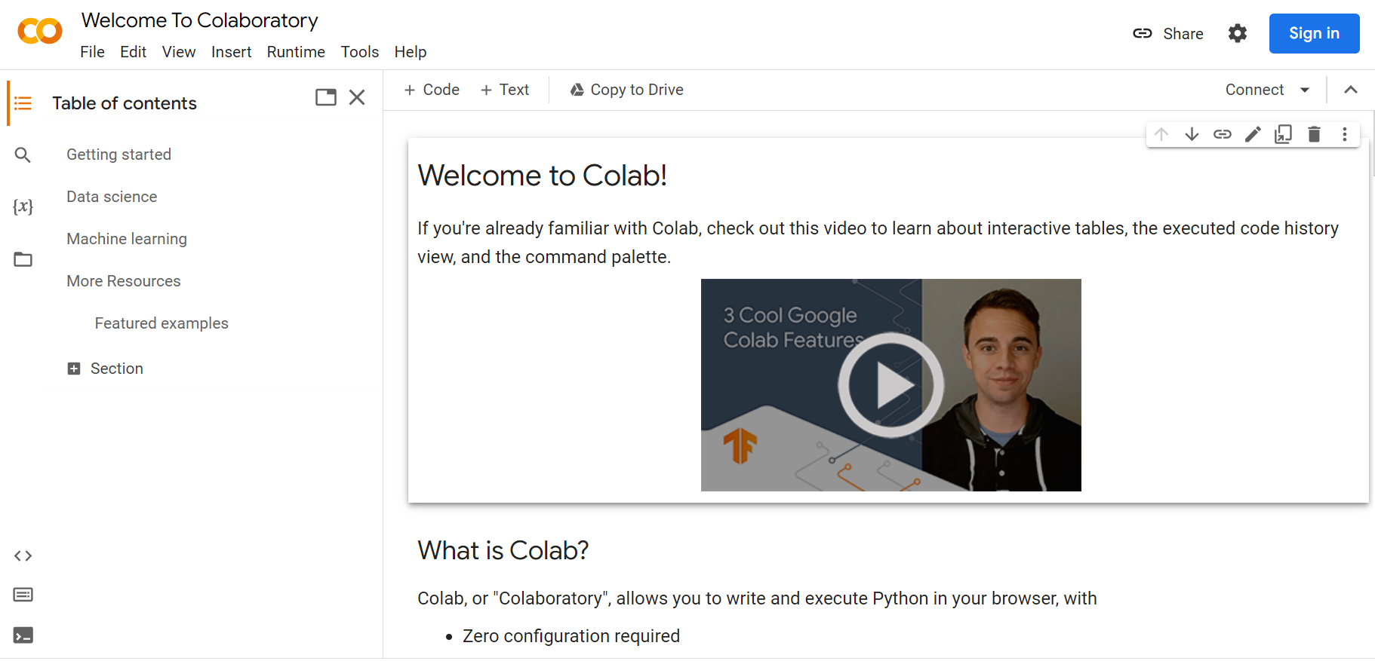
Google Colaboratory
Sign in with your Farmingdale email account and password

Slide 12
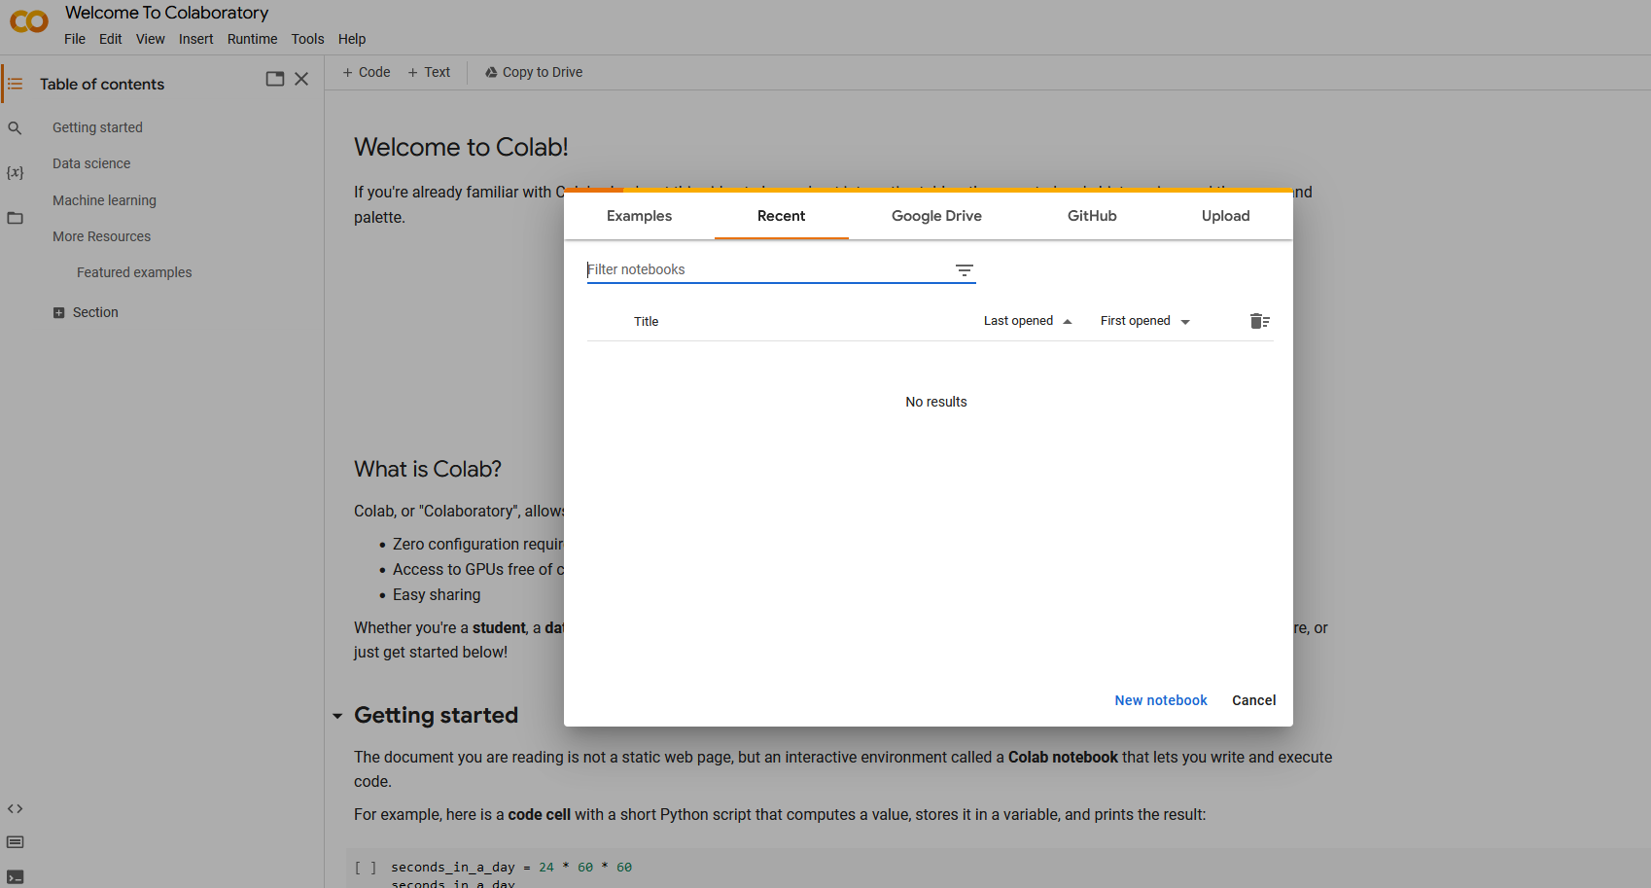
Google Colaboratory
Click on
New notebook

Slide 13
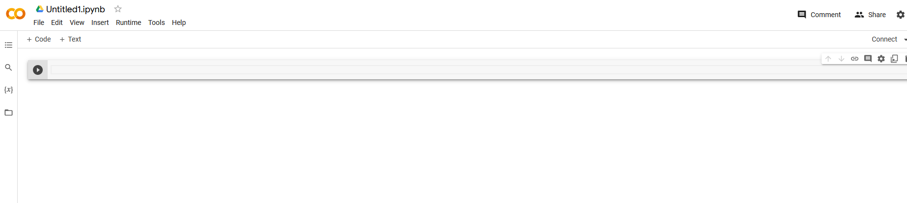
Google Colaboratory
You can rename your document
This document saved as ipynb file extension which stands for “Interactive Python Notebook”

Slide 14
Google Colaboratory
This is called cell

Slide 15
Google Colaboratory
If you want to add a new cell press + Code
If you want to add a text cell too take notes press + Text

Slide 16
Google Colaboratory
In order to execute your code you need to press “play” button

